Slide 1


TYR
^

Slide 2


Slide 3


Slide 4

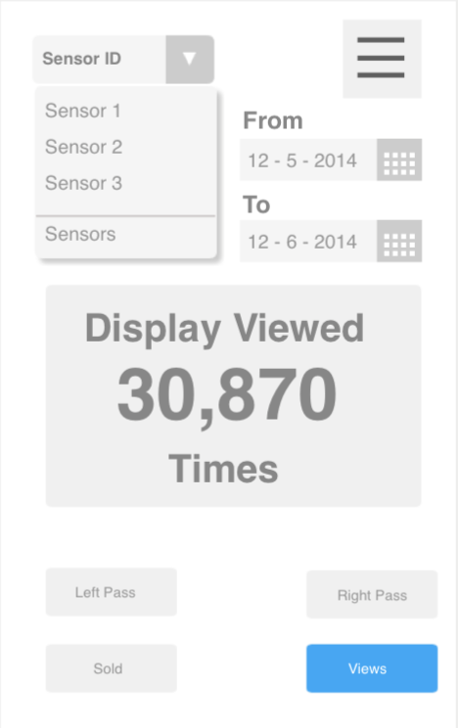

Slide 5
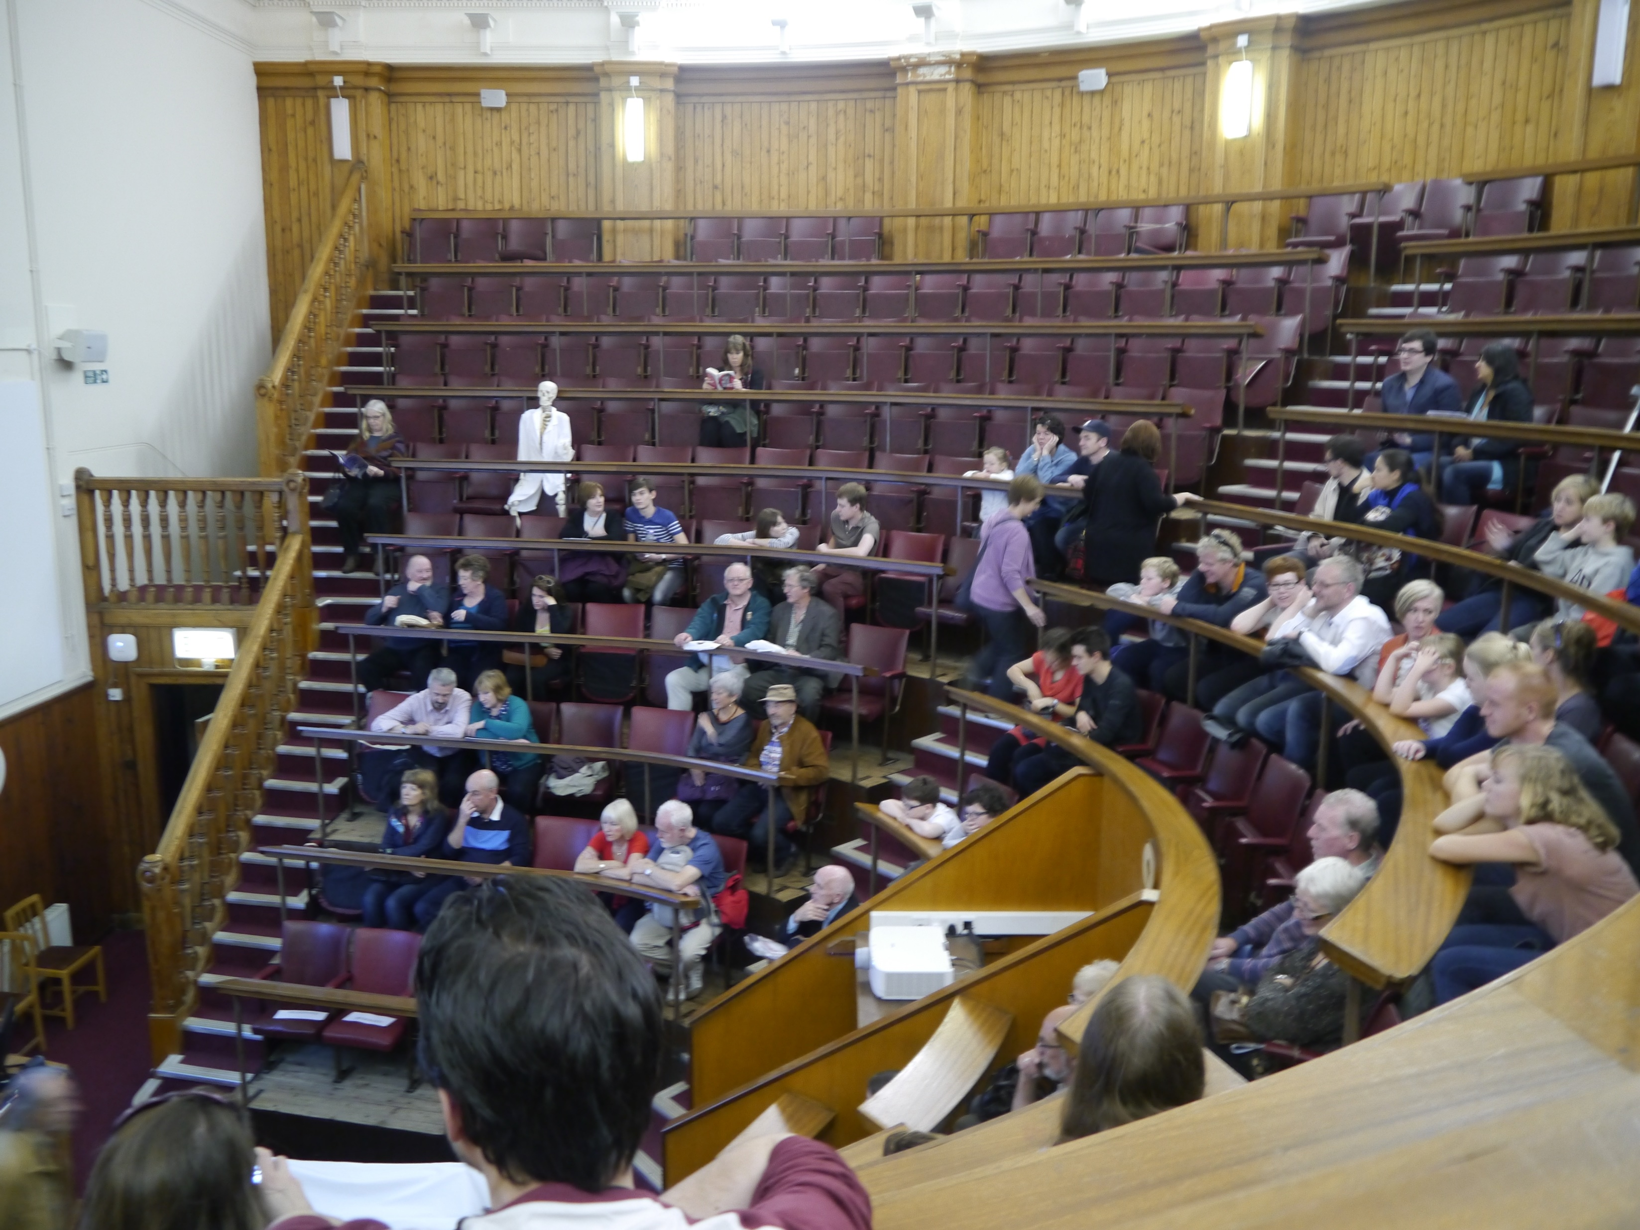

Slide 6


Slide 7



Slide 8


